Slide 1






WEB PROJECT
WEB PROGRAMMING LAB
MCA

Slide 2

INTRODUCTION
GRUB DELIVERY
Grub Delivery is an online food and meal ordering platform, similar to Zomato or Swiggy, where users can explore dishes, place orders, track them live, and share unique, personalized reviews that help others discover popular choices and hidden gems.

Slide 3



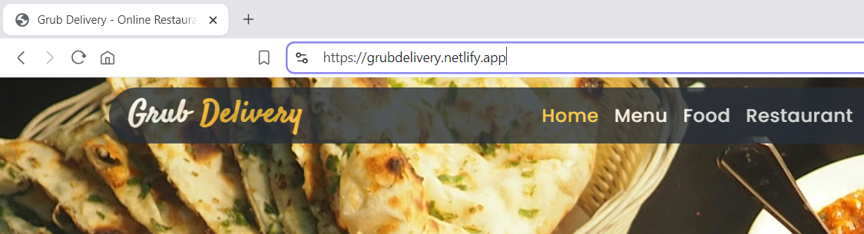
ONLINE LINK
HTTPS://GRUBDELIVERY.NETLIFY.APP/
BUT ONLY FOR VIEW

Slide 4


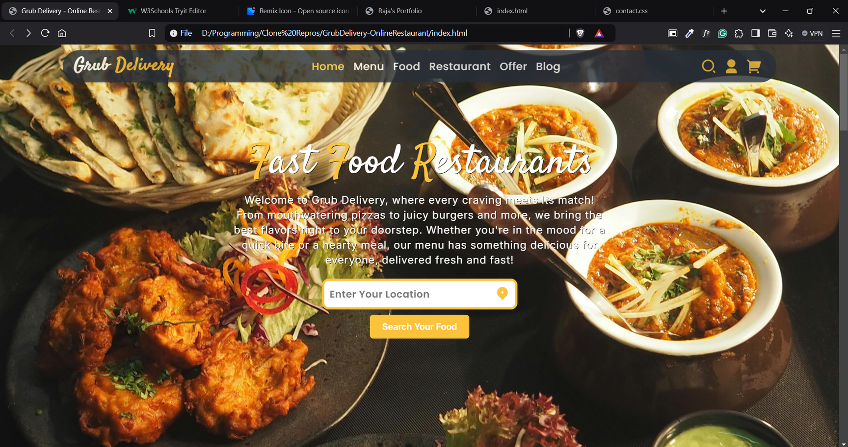
HOME PAGE
NAVIGATION BUTTONS
LOGO
BUTTON FOR SEARCHING FOODS AND & RESTAURATNS
USERS PROFILE
ADD TO CART BUTTON

Slide 5
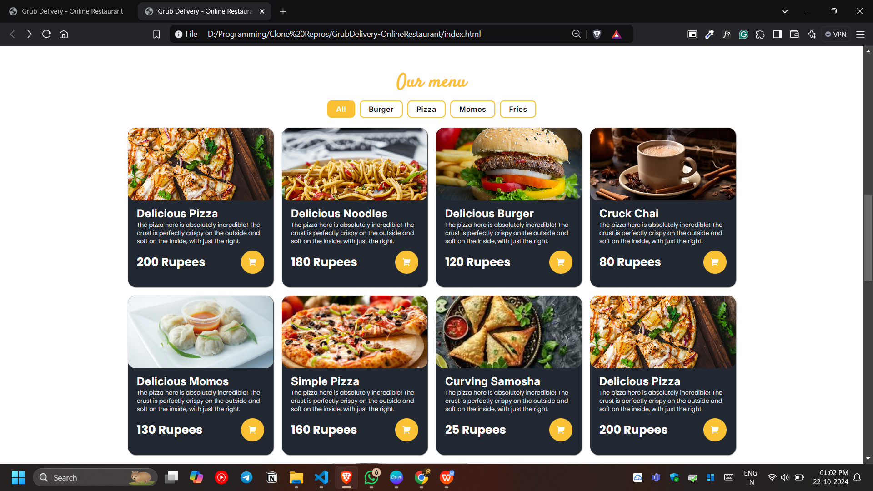
OUR MENU

Slide 6
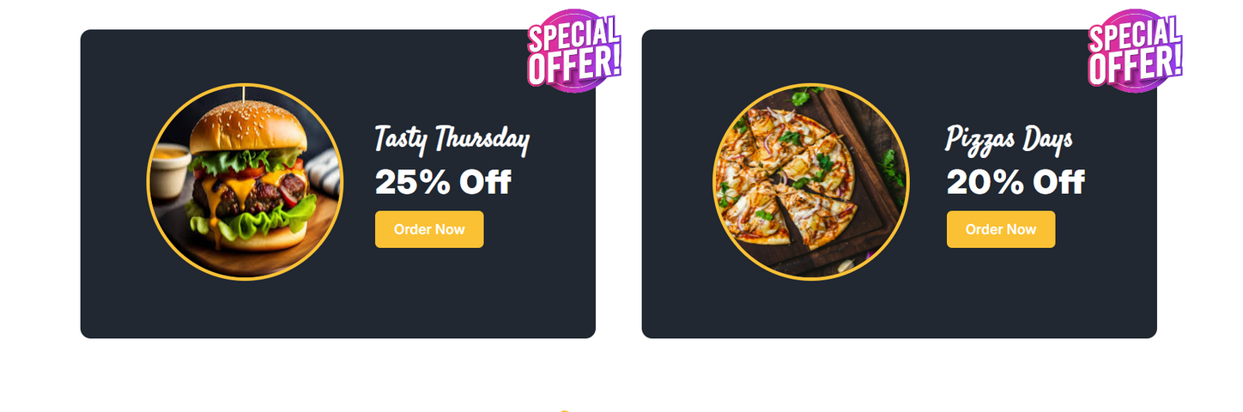
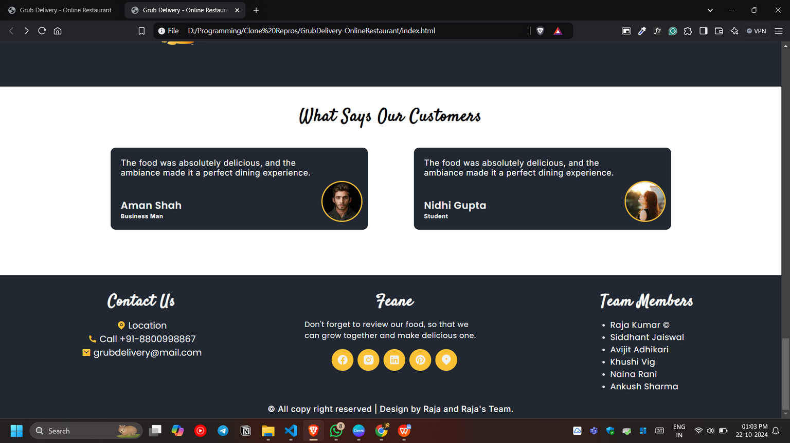
OFFER SECTION
REVIEW SECTION & FOOTER

Slide 7
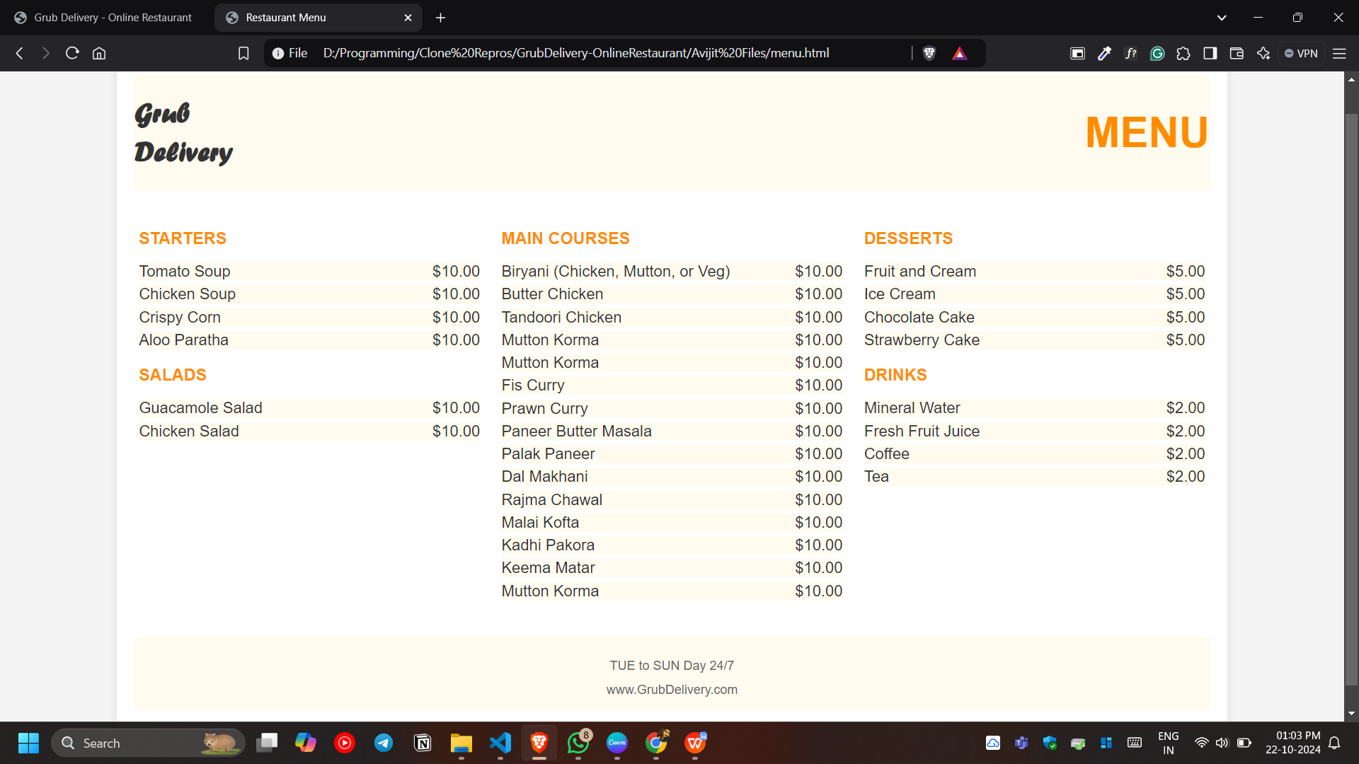
Menu Page

Slide 8
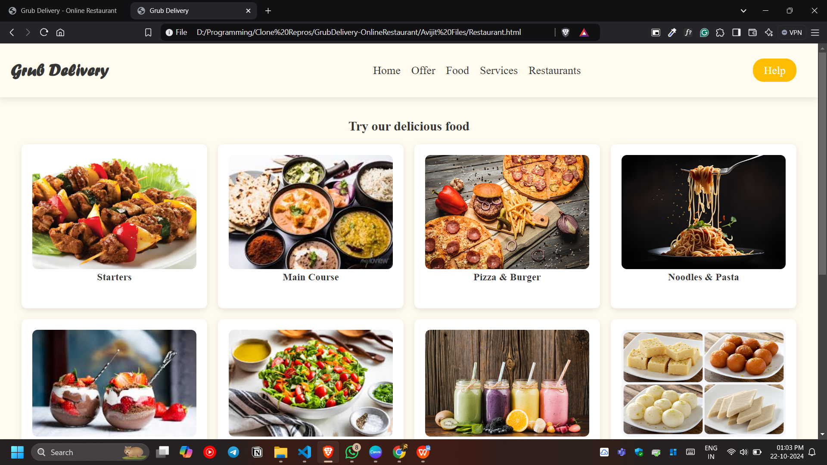
Foods Section Page

Slide 9
Foods Section Page

Slide 10
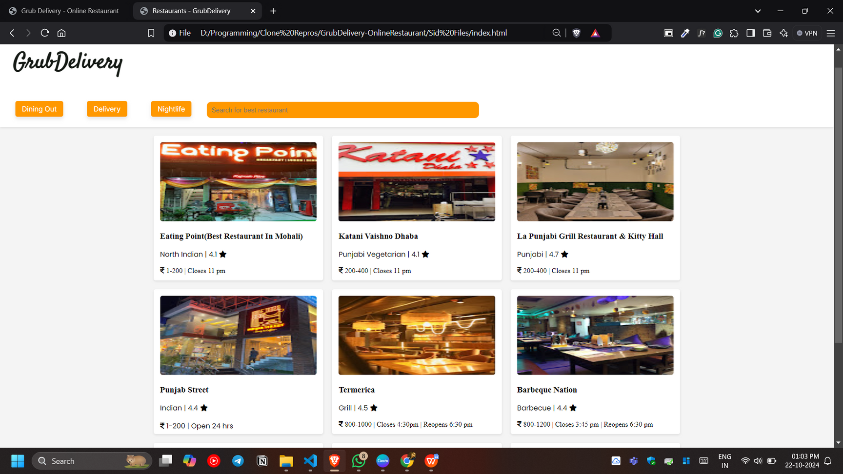
All Restaurants Near User Location

Slide 11
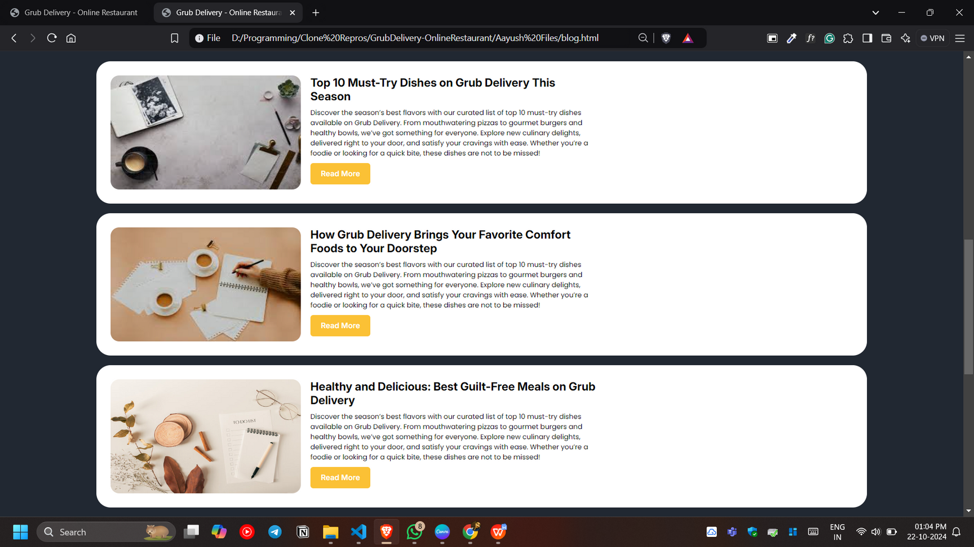
Blog Page

Slide 12



THANK YOU
WARNER & SPENCER
MARCH 2023

